Slide 1
Phosphorus and Potassium
Dorivar Ruiz Diaz
Soil Fertility and Nutrient Management
Kansas State Univ.
Harper Co, Feb. 25

Slide 2
P and K uptake, Corn
P
K
ISU

Slide 3
How are nutrients distributed in wheat?
38 bu/A spring wheat
120
Grain
Straw
100
80
Nutrient content, lb/A
Crop Removal 0.5 – 0.6 lb P₂O₅/bu
60
40
20
0
N
P₂O₅
K₂O
Johnston et al., 1999

Slide 4
Phosphorus

Slide 5
Functions of P in the plant
Energy storage and transfer
ATP and ADP
Processes: respiration, photosynthesis, active ion uptake.
DNA constituent
Required for cell division
Development of meristematic tissue
Critical early in the life of the plant

Slide 6
Inorganic solid-phase soil P
Fe- Al phosphates
Occur in acid soils
Ca phosphates
Occurs in neutral and calcareous soils

Slide 7
P availability in the soil
Greater P sorption with 1:1 clay than with 2:1
Greater potential for positive charge
Presence of Fe and Al oxides.
Soil pH
P most available at 5.5-6.5
Organic matter
Higher P availability w/ high OM (organophosphates complex, Al and Fe coated w/ humus)

Slide 8
Plants take up P as:
Primary orthophosphate ion: H₂PO₄⁻ (pH < 7.0)
Secondary orthophosphate ion: HPO₄⁼ (pH > 8.0)
The form most common is a function of soil pH – both equally present at neutral pH

Slide 9
Root development: 1-2 leaf stage
Crown
0
Rooted soil volume
2
First seminal pair
Depth, in.
4
6
Primary root
8
6
4
2
0
2
4
6
Distance from the seed row, in.
Winter wheat
Veseth et al., 1986

Slide 10
Root development:4 leaf stage, 1 tiller
Crown
0
Second seminal pair
First crown root
2
Depth, in.
First seminal pair
4
6
8
6
4
2
0
2
4
6
Distance from the seed row, in.
Winter wheat
Veseth et al., 1986

Slide 11
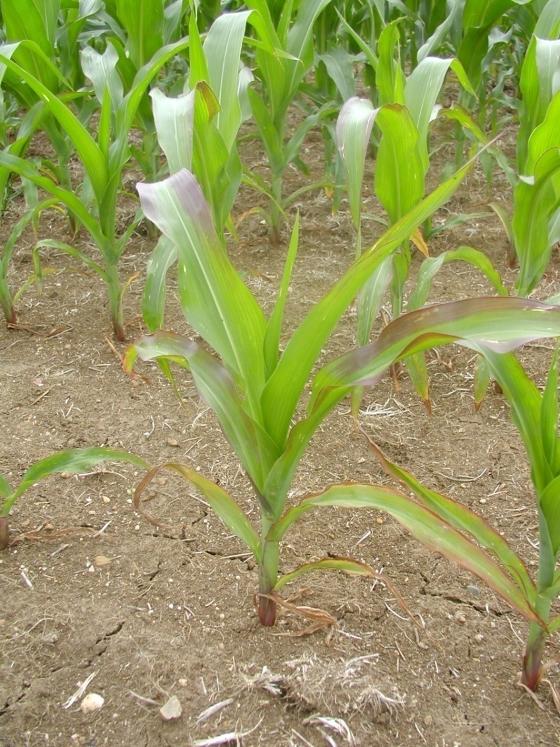
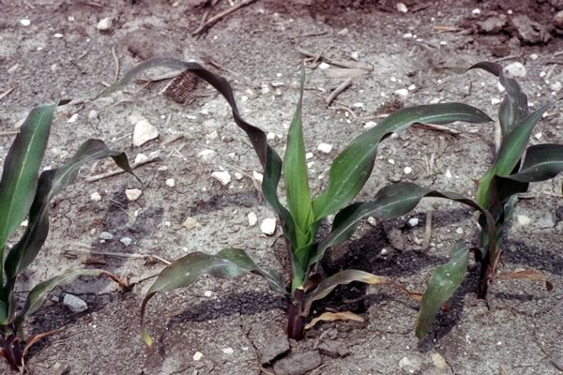
P Deficiency Symptoms- Corn
J. Sawyer, ISU

Slide 12
Soil Test P
Soil test to know what P application rate are really needed.
Avoid applications to fields or field areas that do not need the nutrients or lime.
Compared to the cost of nutrient and lime inputs, soil testing is inexpensive and provides a good return on investment.
Evaluate soil test results to determine Phosphorus requirements.

Slide 13
Soil test P change
30 lb P₂O₅/acre
Barney Gordon, 2008
Soil test P, ppm
Year
Higher P rates to maximize yield and maintain soil test levels?

Slide 14
Probability of Fertilizer Response
P Test Level, ppm | Probability of Response
<5 | 85-100%
6-12 | 60-85%
13-20 | 30-60%
20-30 | 10-30%
>30 | 0-10%
Use soil tests to predict the “Probability of response” and the likely “magnitude of response”

Slide 15
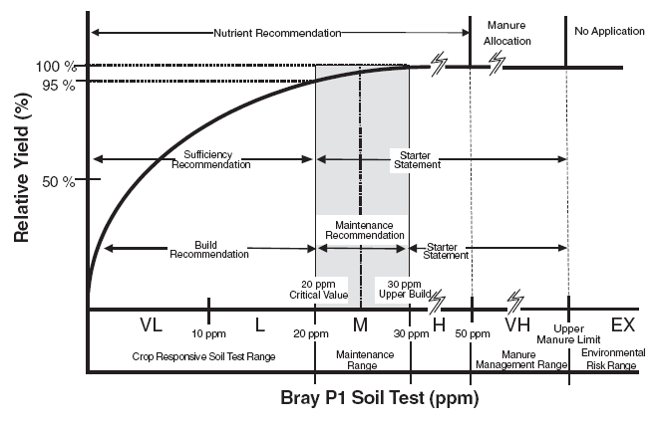
Corn, grain sorghum and wheat Phosphorus

Slide 16
Corn, Grain Sorghum and Wheat P Sufficiency
Kansas State University

Slide 17
Approaches to P fertilization
Sufficiency approach: Apply P to maximize net returns to fertilization in the year of application
Strategy: fertilize only when there is a good chance that a profitable yield response will be realized
Soil test levels kept in lower, responsive ranges
Normally adopted on land leased for short periods of time or when cash flow is limited
Relative yield, %
Soil test P level

Slide 18
Approaches to P fertilization
Build and maintenance approach: Remove P as a yield-limiting variable
Strategy: apply extra P (more than expected crop removal) to build soil tests to levels that are not yield-limiting
Soil test levels kept in higher, non-responsive ranges
Normally adopted on owned land or land leased for longer periods of time
Relative yield, %
Soil test P level

Slide 19
What happens to fertilizer P after I apply it?
Solution P:
10 to 30 % of applied P
Immediately available
Labile P:
70 to 90% of applied P
Future supply
Metastable Ca-phosphates
Solution P
Labile P
Non-labile P
IPNI, 2009

Slide 20
Net return to 46 lb of P₂O₅
$4.5/bu Corn
$0.6/lb P₂O₅
Returns to 46 lb P₂O₅, $/acre
Phosphorus test Bray-1, ppm
Antonio Mallarino
Iowa State University

Slide 21
Long-term Corn Fertility
0 P
40 P
80 P
200 lb N/a/yr
2005
Long-term corn fertility Tribune, KS 2006

Slide 22
Long-term Corn Fertility
40 P
0 P
80 P
0 lb N/a/yr
2005
Long-term corn fertility, Tribune, KS 2006

Slide 23
Simulated corn net return to uniform and variable application
Net returns $/acre
Dale Leikam, K-State

Slide 24
Variable rate application?
Precision in the application of fertilizer is highly dependent on the information derived soil test.
Intensive sampling program represents an increased cost over conventional sampling.
There must be an economic advantage from either increased crop yields, or reduced fertilizer costs.

Slide 25
Variable rate application?
Identify parts of a field that could respond to higher rates of fertilizer.
Savings from reduced fertilizer application: only if non-responsive areas of a field are identified.
Benefits can only be determined on a field-by-field basis.
The challenge is to identify opportunities for increased net income with sufficient precision without excessive cost.

Slide 26
Making P fertilization decisions
P should be applied where the chance of yield increase is large.
Expected yield increase is sufficient to at least pay for the applied fertilizer.
Consider, manure can supply P and K (as well as N and other nutrients)… market value has also increased with high fertilizer and fuel prices.
Manure maybe is not not available in some areas.

Slide 27
Potassium
Absorbed by plant as K+ ion
Unique nutrient - not a part of any plant compound - exists in plant sap
Functions in plant
Activation of > 60 different enzymes
Role in photosynthesis and metabolism
Conversion of N to protein (high levels required for high protein crops)
Reduces plant disease

Slide 28
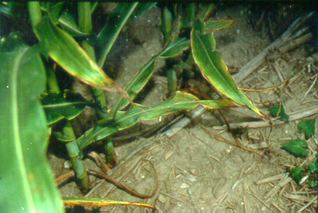
Potassium
Factors Affecting K Uptake By Plants
Poor Soil Aeration
Oxygen required for root uptake
Ridge-till/No-till
Compaction
Soil Moisture
Very dry
Very wet
Soil Temperature
Cold

Slide 29
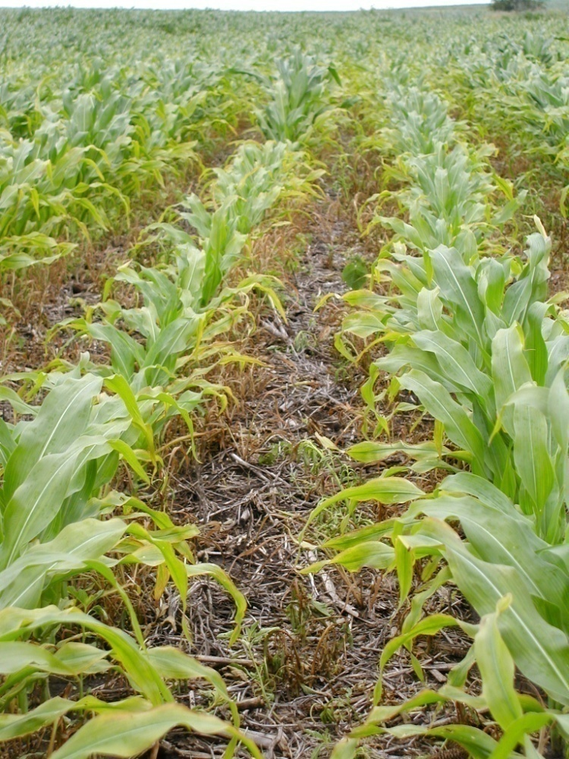
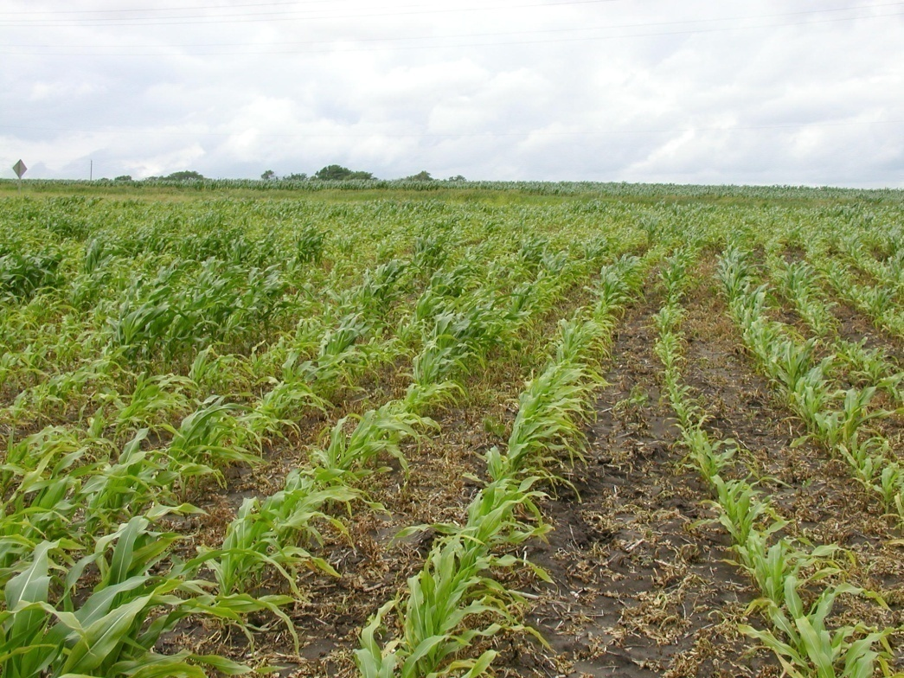
Potassium Deficiency
D. Laikem

Slide 30
Readily Available K
K⁺
K⁺
K⁺
K⁺
Exchangeable plus solution forms
Soil tests extract these forms
K absorbed by plants in solution phase
Equilibrium replenishes K⁺ ions in the soil water from exchangeable or slowly available forms
K⁺
K⁺
K⁺
K⁺
K⁺
K⁺
K⁺
K⁺
K⁺
K⁺
K⁺
K⁺
(Exchangeable)
Montmorillonite

Slide 31
Unavailable K
Mica, feldspar and clay minerals contain 90% to 98%
Decompose releasing K⁺ ions
Great Plains rich in K compared to eastern states with precipitation >30 inches

Slide 32
Potassium Recommendation
Corn Suffi ciency K Rec = [ 73 + (Exp. Yield × 0.21) + (Exch K × -0.565) + (Exp Yield × Exch K × -0.0016) ]

Slide 33
If K is greater than 130 ppm then only a NPK or NPKS starter fertilizer is suggested
If K is less than 130 ppm then the minimum K Recommendation = 15 Lb K2O/A

Slide 34
Manure vs Fertilizer Nutrients
Large concentration variability.
N-P-K content and crop needs.
Amount of N and P availability shortly after application.
Expensive storage and handling, difficulty for uniform application.
Large soil-test variability.
Producer's doubts about its value.

Slide 35
Manure vs Fertilizer Nutrients
 | % Dry Matter | Total N | NH₄ | P₂O₅ | K₂O
 |  | - - - - - - - lbs/ton - - - - - -
Dairy | 21 | 9 | 5 | 4 | 10
Beef | 50 | 21 | 8 | 18 | 26
Swine | 18 | 8 | 5 | 7 | 7
Poultry | 75 | 56 | 36 | 45 | 34

Slide 36
Manure Nutrient Concentration

Slide 37
Crop Availability of Manure Nutrients
No organic K, all available, no doubt.
Variable proportion of inorganic and organic N, P, and S. Organic forms must be mineralized to be absorbed.
Mineralization rates vary with the handling method, application method, and climate/field conditions.
N and P availability immediately after application is difficult to predict.

Slide 38
Nutrient Availability in Practice
All manures are heterogeneous materials, difficult to handle.
High nutrient variability, difficult to apply uniformly at precise rates, uncertain climatic conditions, high soil-test variability in manured fields.
This may reduce manure nutrients efficiency compared with fertilizers.
But careful management pays back.

Slide 39
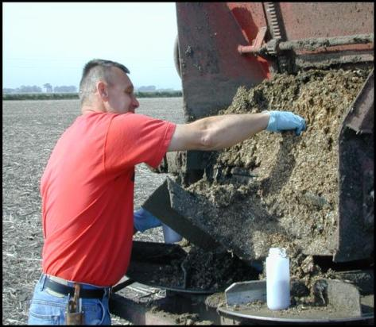
Use “pre-application” manure sample lab analysis, but go back and determine the actual nutrient rates applied.
Calibrate application equipment.
Work with N, P, K application rate and not just gal or ton per acre.
Know the manure nutrient analysis.
Use total manure N to base application rate.

Slide 40
Questions?
Dorivar Ruiz Diaz
ruizdiaz@ksu.edu
785-532-6183

